Slide 1
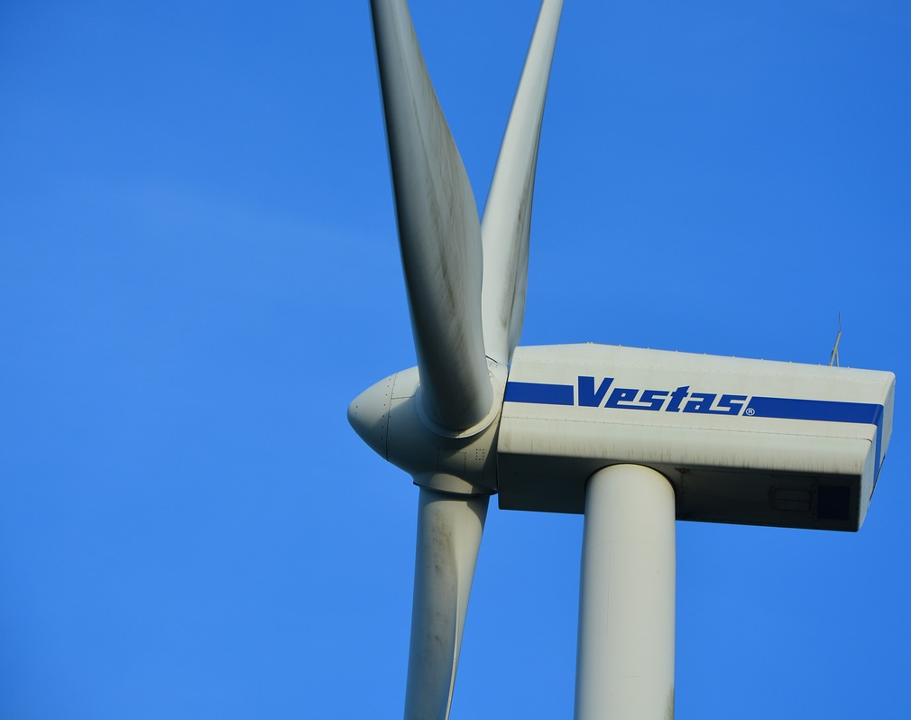
Maritime Wind Speed Prediction Using Buoy LIDAR Data
Team: Brian Waite, Carl Walenciak
Southern Methodist University
Time Series Analysis
Prof. B. Sadler

Slide 2

Problem Statement:
Forecast wind speed at a theoretical wind turbine 10 minutes ahead using historical wind (univariate) and meteorological (multivariate) data.

Slide 3
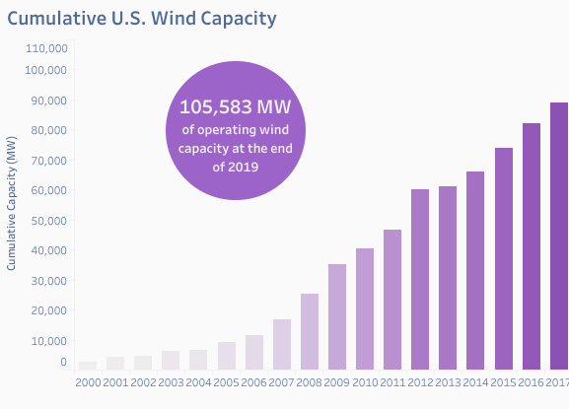
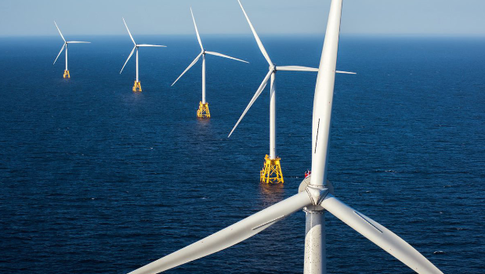
U.S. Wind Industry
Potential Wind Capacity in U.S. (at 80m turbine hub height) is 10,640,000MW.
Only 1 Offshore U.S. wind farm in operation today.
30 MW farm at Block Island, RI
By 2026, 9,112 MW of installed offshore wind capacity anticipated.
https://www.awea.org/Awea/media/Resources/Fact%20Sheets/Offshore-Fact-Sheet.pdf

Slide 4
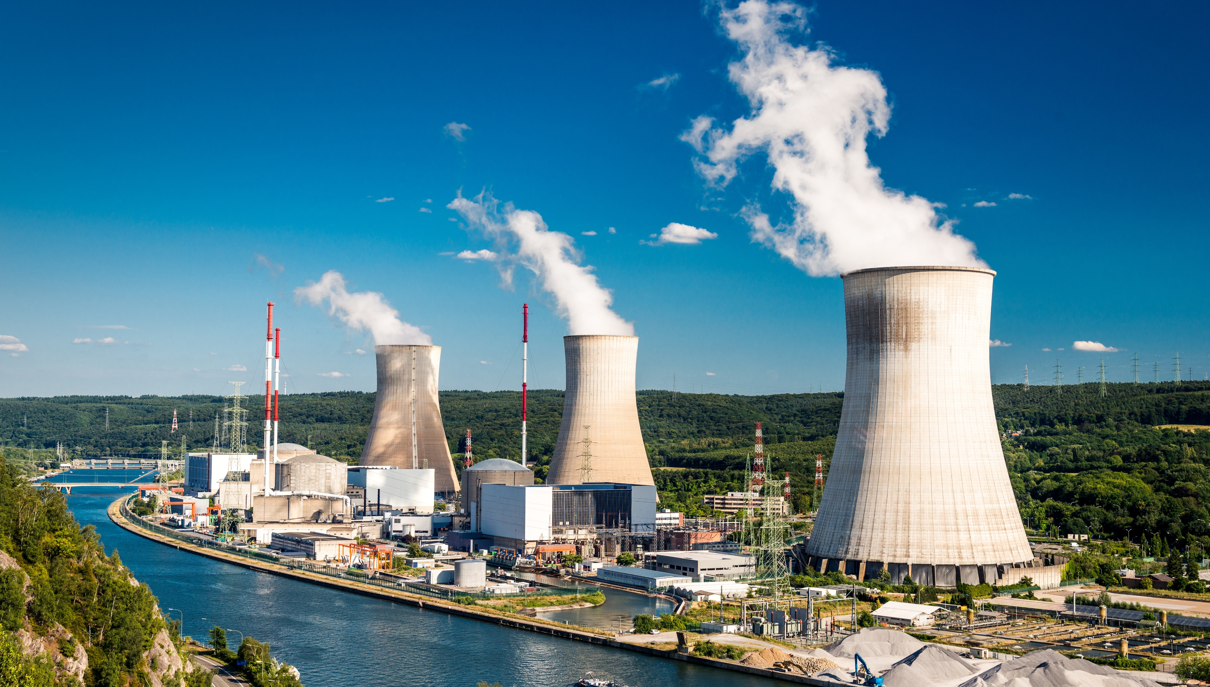
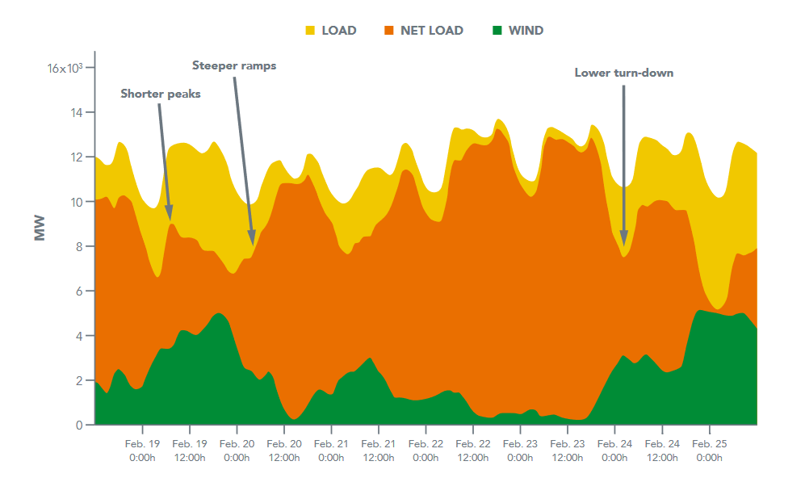
Challenge of Wind Integration
U.S. Energy Grid is continuously struggling for balance between generation and load.
Wind variability directly impacts the need for conventional power plants to shape capacity in response.
Causes additional wear on equipment, inability to match load, affects cost return model of conventional plants.
https://www.nrel.gov/docs/fy14osti/61721.pdf

Slide 5
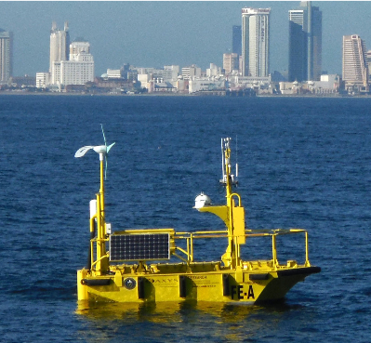
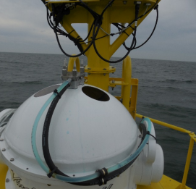
What is Buoy LIDAR Data?
Pacific Northwest National Labs (PNNL) in support of U.S. Department of Energy (DOE)
Buoy collects comprehensive meteorological and oceanographic data characterize offshore wind energy.
LIDAR – LIght Detection And Ranging
Using Data from April 2016 buoy deployment. (Specifically 01-20 April)
https://wind.pnnl.gov/lidarbuoyloanprogram.asp
https://wind.pnnl.gov/pdf/Example_Monthly_Report.pdf

Slide 6
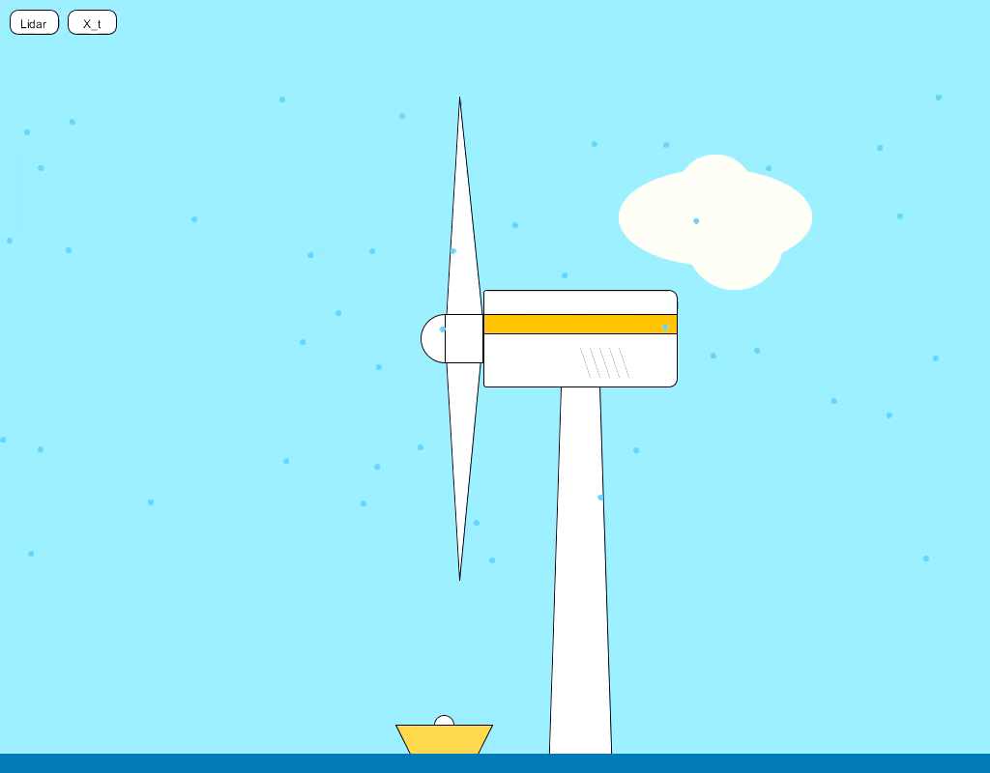

Slide 7
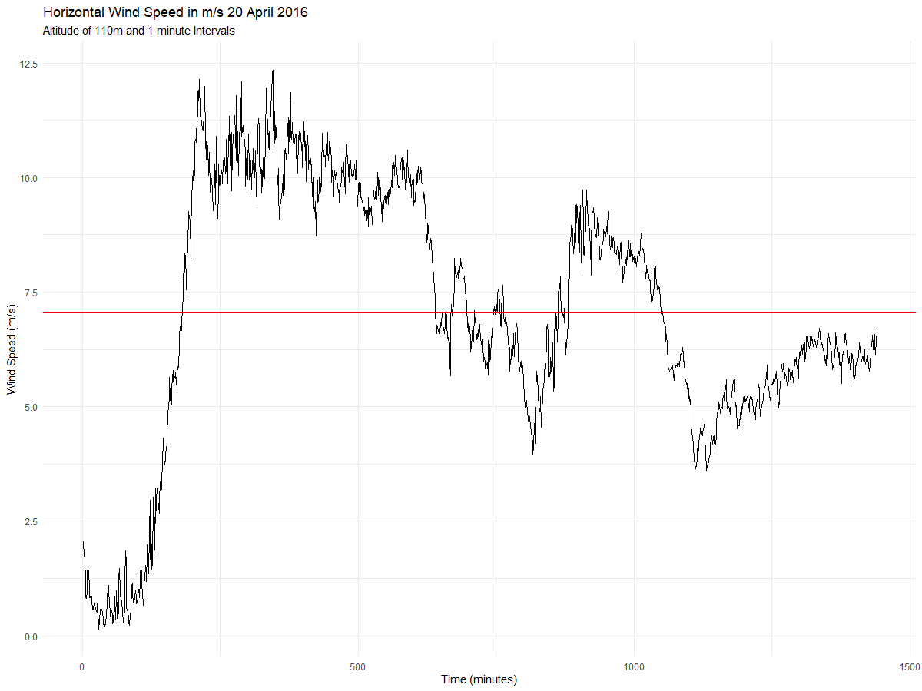
Realization
X_{bar}
But what does it mean?

Slide 8
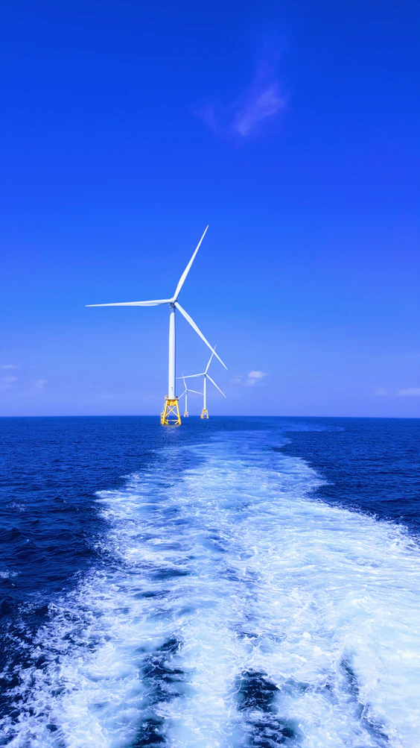
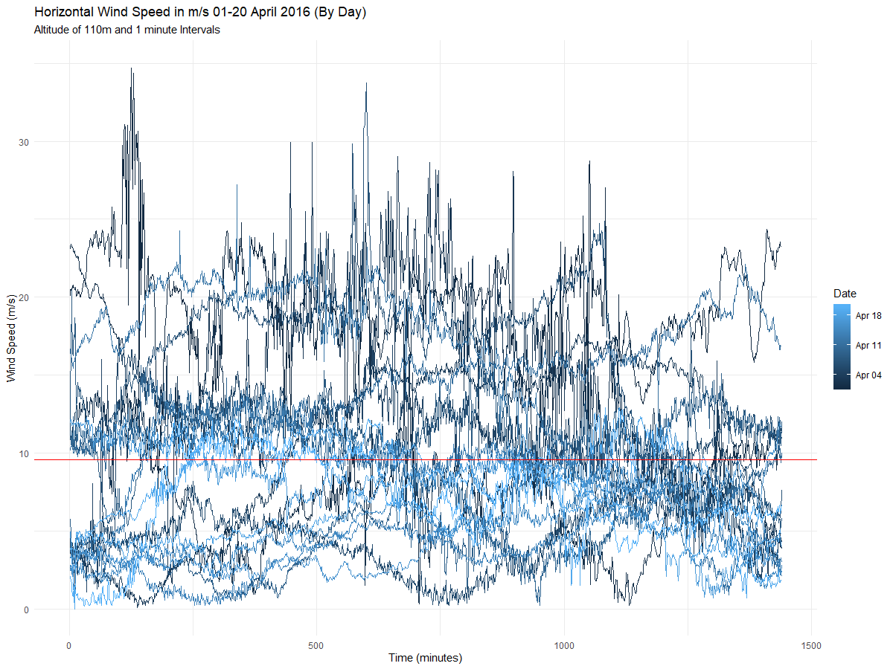
Note about distribution:
Our research indicates wind follows a Weibull distribution (right skewed), but we assume normality to be able to continue with research.

Slide 9

Stationarity Evaluation
Condition 1: Mean does not depend on time
Condition 2: Variance does not depend on time
Condition 3: Autocorrelations constant regardless of where we look in the series

Slide 10
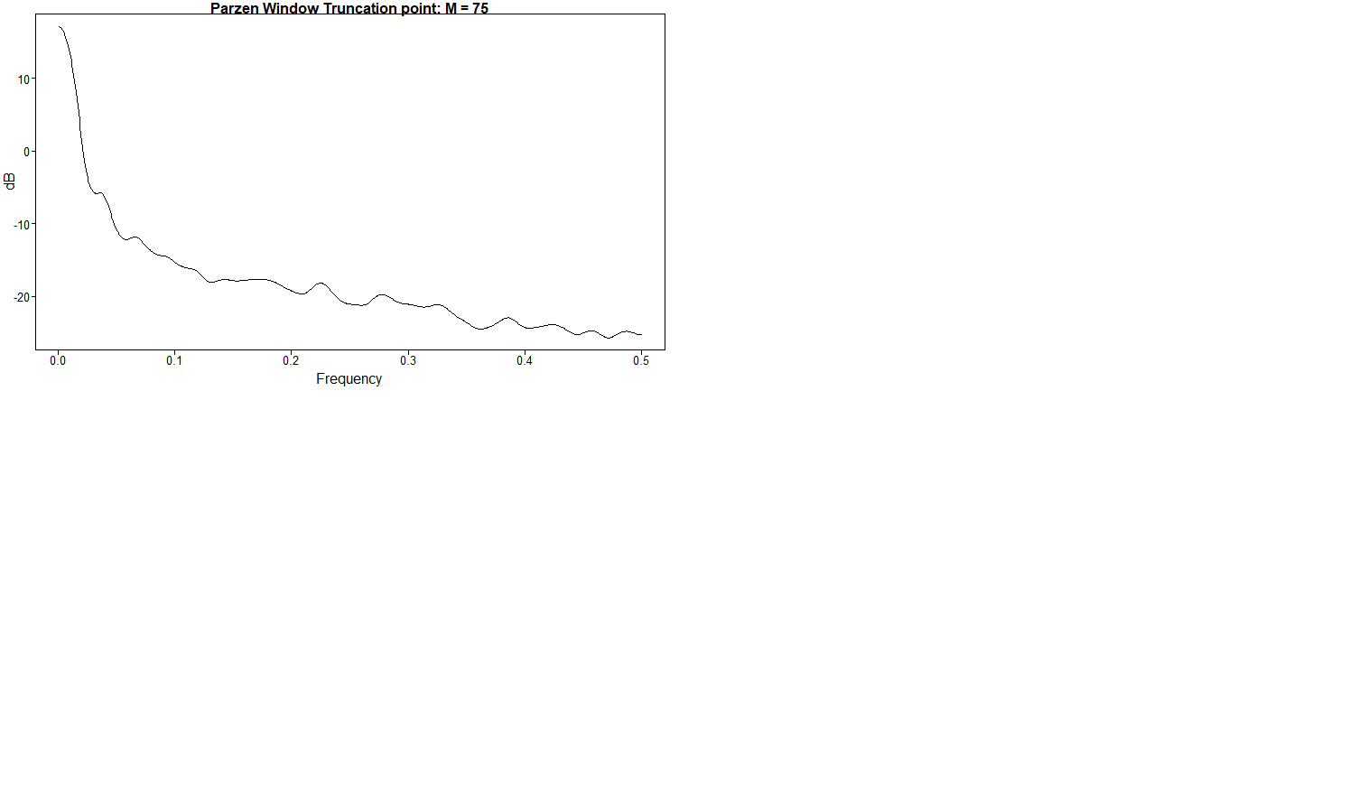
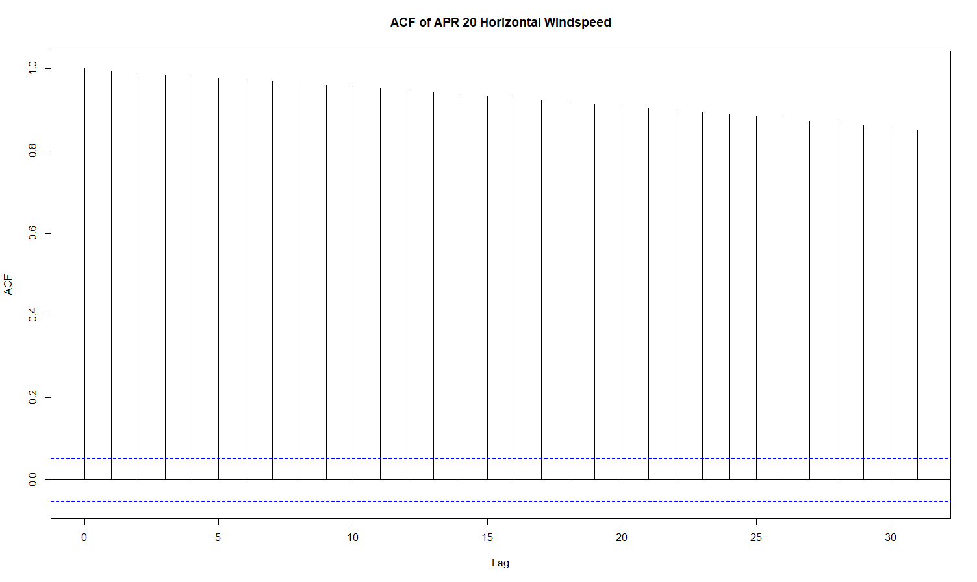
Spectral Density and Autocorrelation

Slide 11
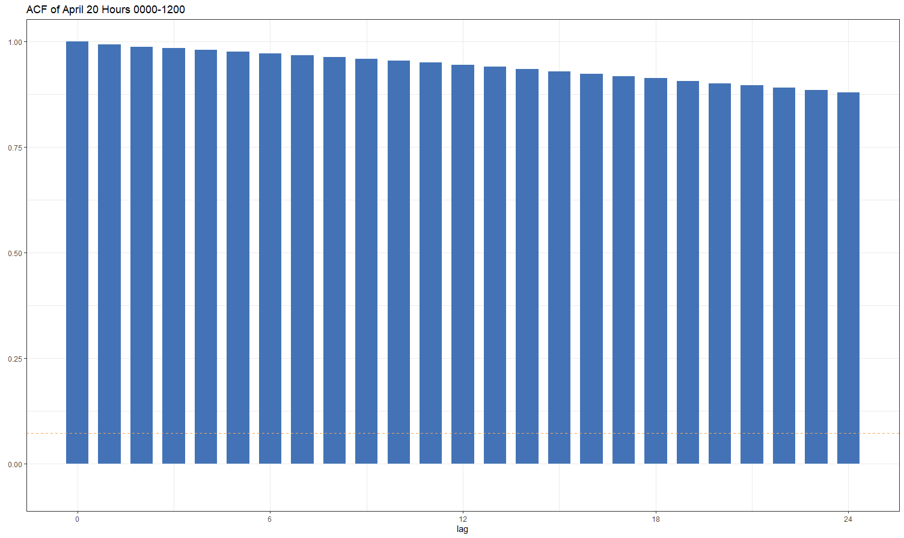
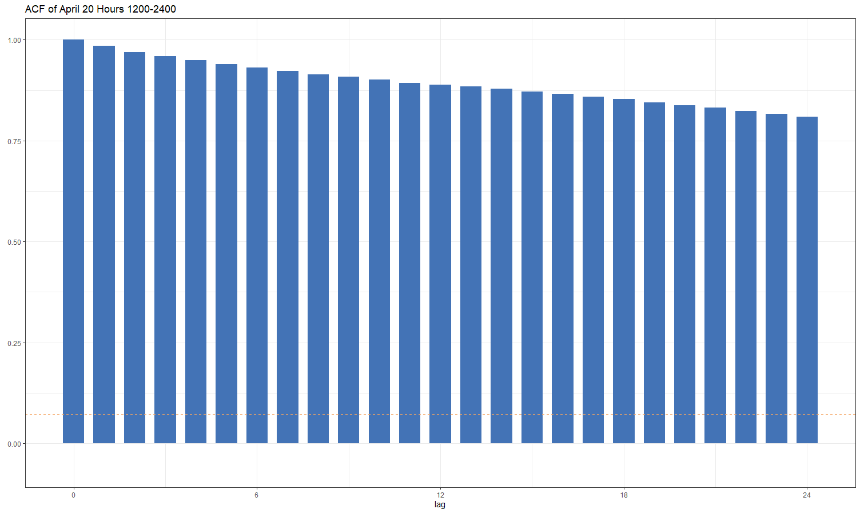
Stationarity Evaluation
Condition 1: Mean does not depend on time
Condition 2: Variance does not depend on time
Condition 3: Autocorrelations constant regardless of where we look in the series
Note the slight oscillation, particularly in the second half
STOP
But wait! Those autocorrelations are really damping slowly…

Slide 12
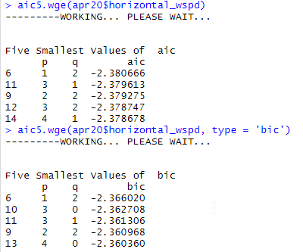
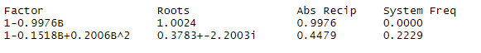
Potential Stationary Models
ARMA (1,2)
$\left(1−0.998B\right)\left(X_{t}−7.04\right)={(1−0.13B −0.22B^{2})a}_{t}$ ${\hat{σ}}_{a}^{2}=0.092$
ARMA (3,1)
$\left(1−1.149B+0.352B^{2}− 0.2B^{3}\right)\left(X_{t}−7.04\right)={(1−0.287B)a}_{t}$ ${\hat{σ}}_{a}^{2}=0.092$
Take note! Looks like the ARMA(3,1) was able to capture the small system freq at 0.22 we saw in the original Parzen SD

Slide 13
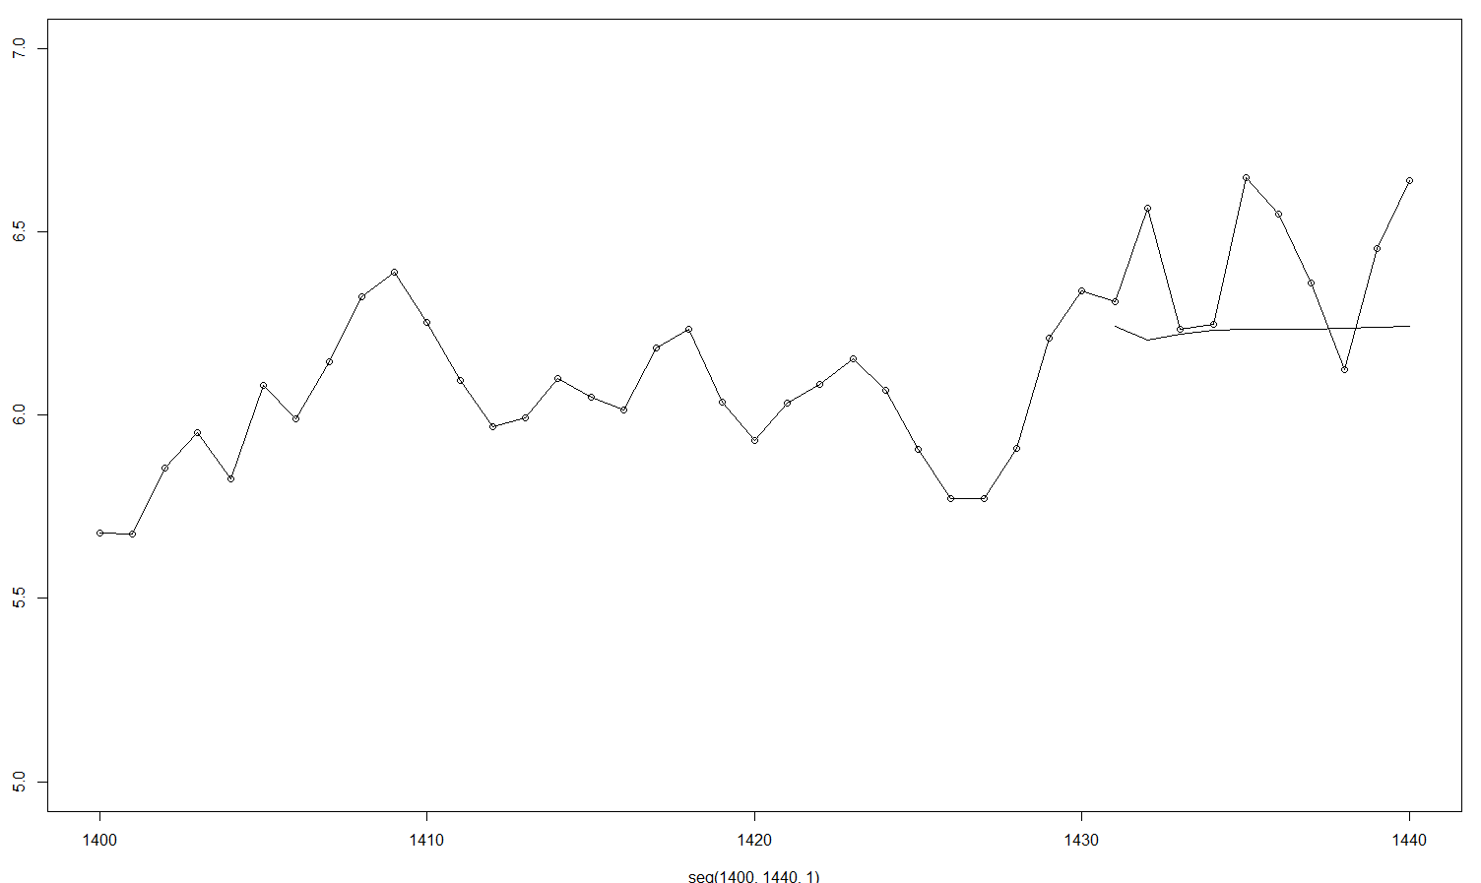

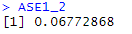
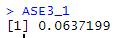
Forecast Evaluation (n.ahead = 10)

Slide 14
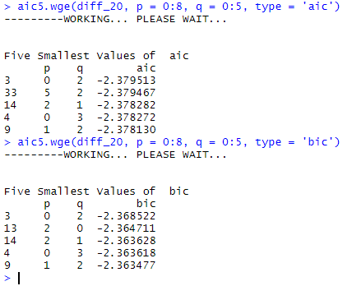
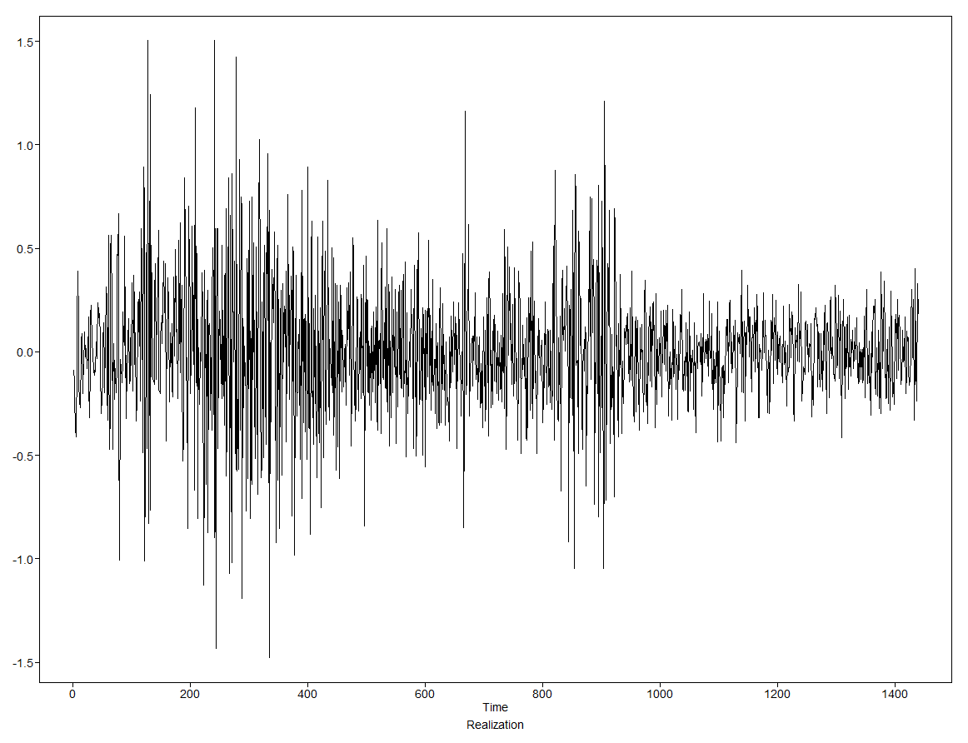
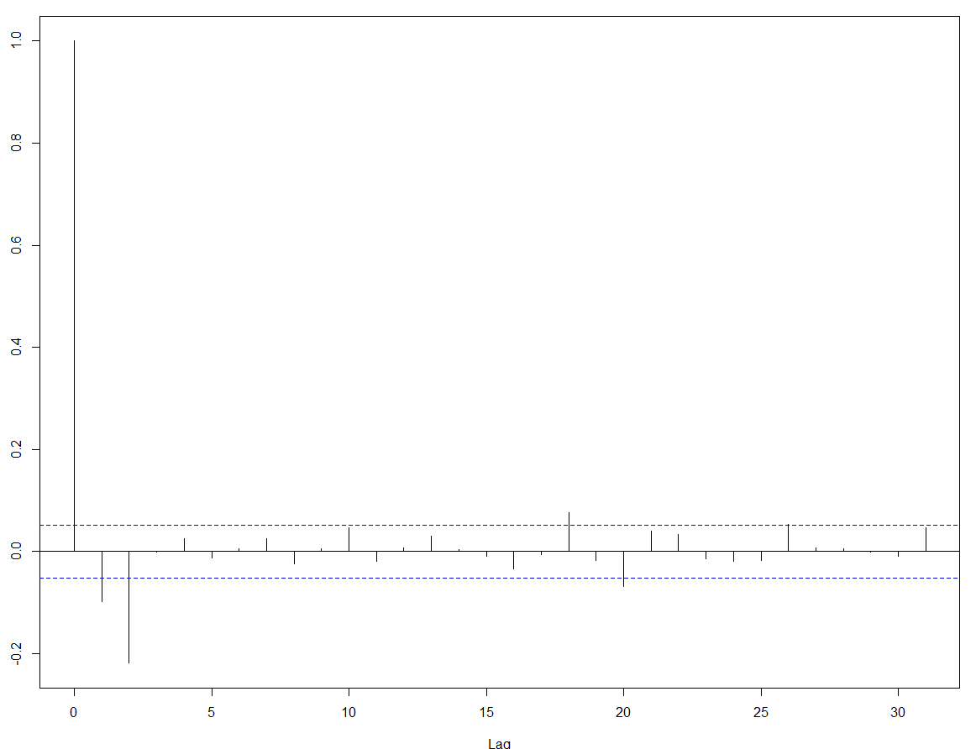
Let’s add a (1-B)
First Differenced Data
ACF of Differenced Data
We see this change in variance and are deferring it to assume stationarity here until further examination is possible.
…but we know that MA models do not typically describe real-world processes, so let’s go with the ARMA(2,1) that is present in both above and model the differenced data.
Looks like some MA behavior here. (2-lags then drops)
$\left(1−0.16B+0.2B^{2}\right)(1−B)\left(X_{t}−7.04\right)={(1−0.298B)a}_{t}$ ${\hat{σ}}_{a}^{2}=0.092$

Slide 15
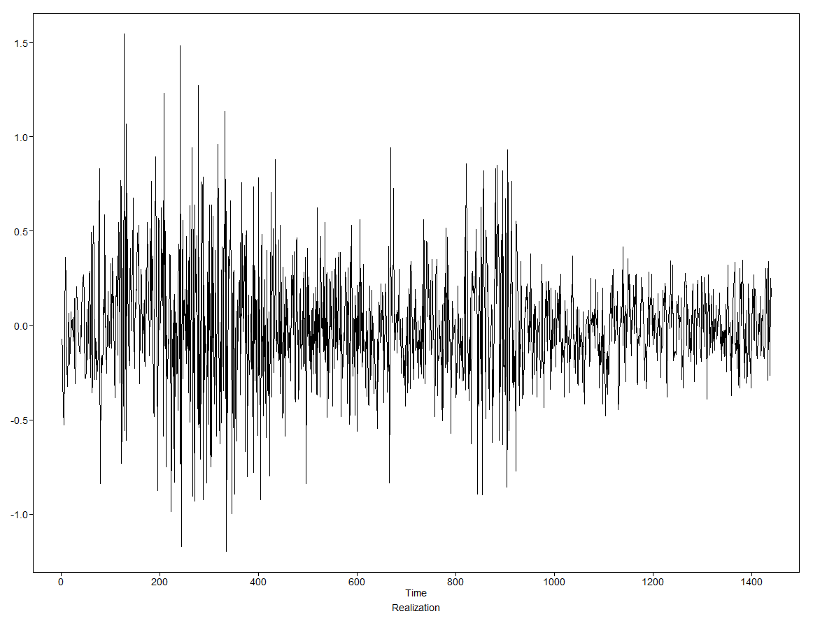
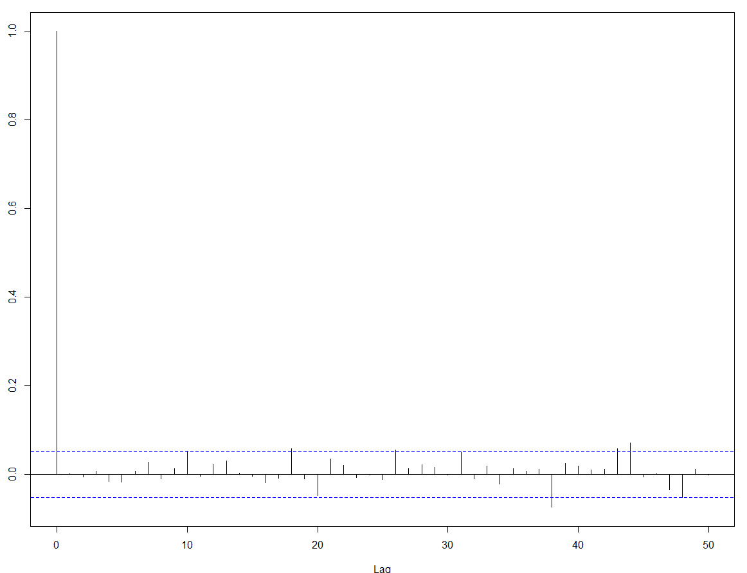
Let’s look at the residuals…
Looks like there may still be something (albeit small) to be modeled out in the residuals. We know there may be a diurnal cycle to off-shore wind patterns that we might explore.
Ljung-Box K=24; p = 0.519
Ljung-Box K=48; p = 0.067
Fail to reject the null hypothesis of White Noise at alpha = 0.05, but close at K = 48

Slide 16
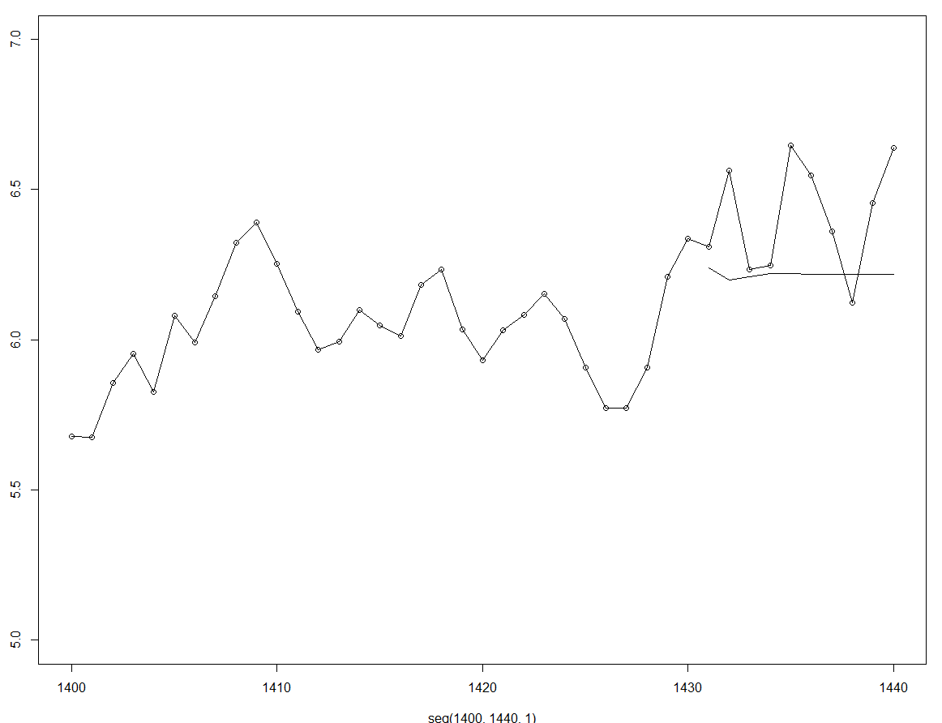
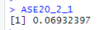
Forecast results with non-stationary:
ASE Approximately the same, but utility still unclear. Needs more exploration.

Slide 17
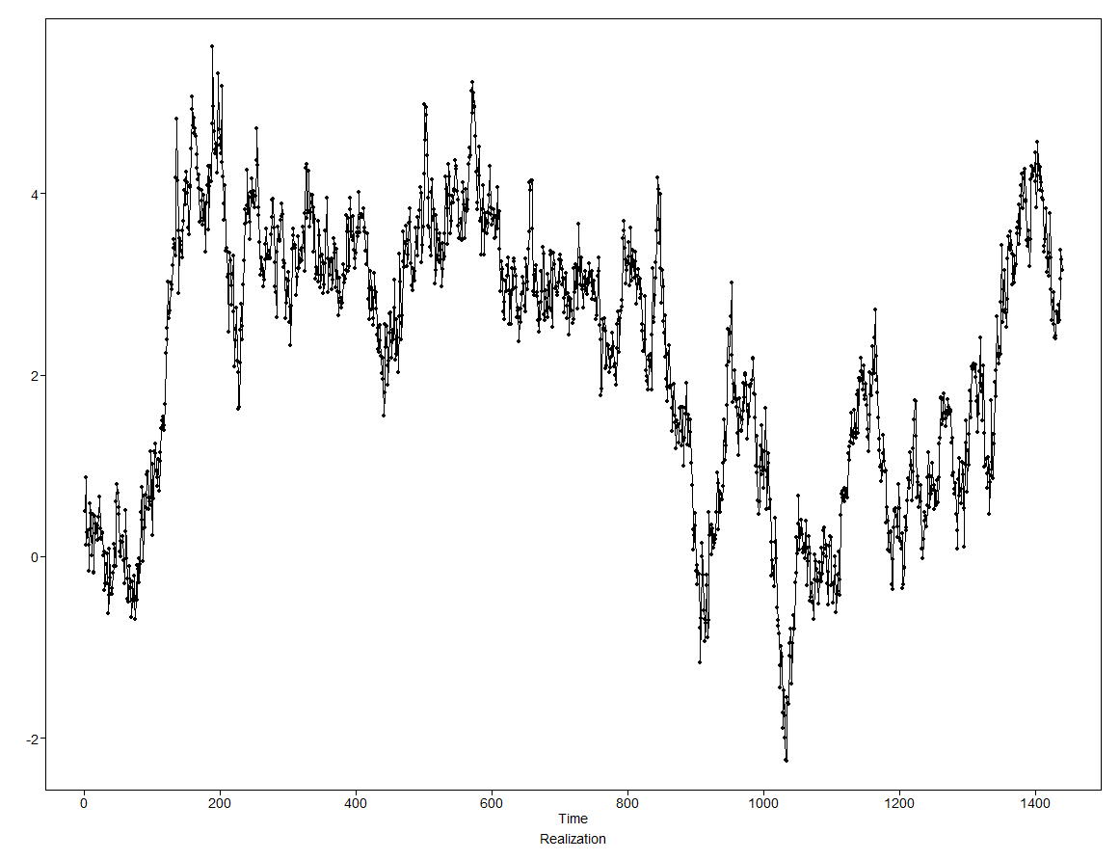
Generating data with our model to see how it looks… …pretty, pretty, pretty good.

Slide 18

Plan for future analysis:
Continued evaluation of Moving Average smoothing or different time intervals to help smooth the model (if needed).
Transform for distribution assumptions.
Continue to learn new techniques to model this series including:
Neural networks
Adding explanatory variables
Ensemble models
Continue to refine visualizations and explore how far to push forecast horizons while still maintaining reasonable accuracy.
Determining which model is the most useful!

